Slide 1

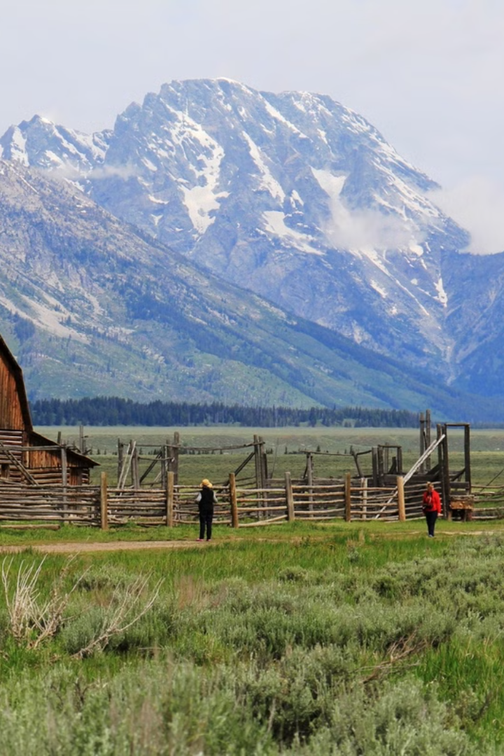
AgroQuality: Empowering Farmers and Freelancers
AgroQuality is a comprehensive website that revolutionizes the way we assess farm quality and connect freelancers with agricultural assessing opportunities. By leveraging cutting-edge technology and a user-friendly interface, freelancers can create their client's farm thorough assessment report and provide a service to the farmers based on instructing them what they needs to practice on their farm to improve farm's health.

Slide 2
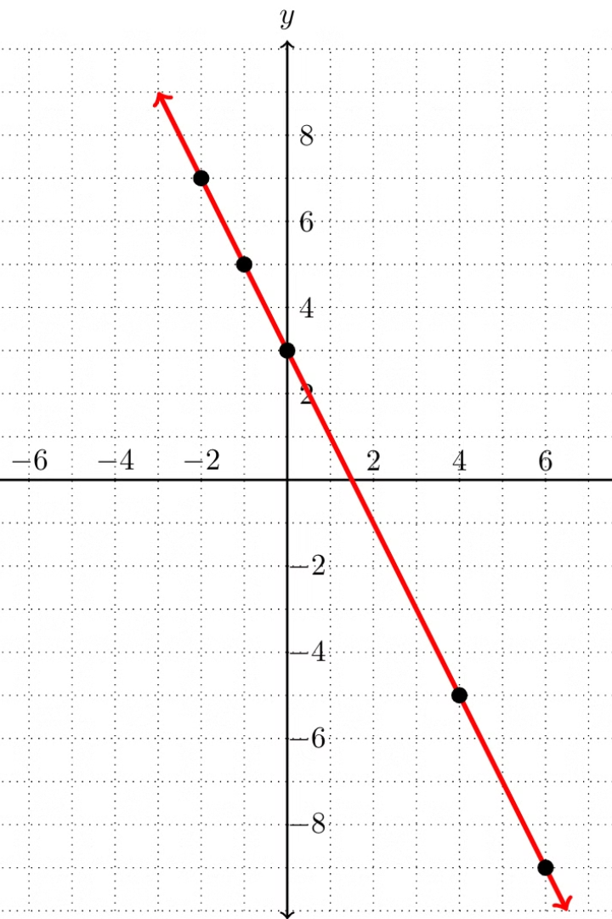
AgroAPI: Farm Quality Assessments
1
AgroAPI:
AgroQuality integrates AgroAPI seamlessly with farm details, enabling real-time data collection and analysis for comprehensive quality assessments.
2
Precision Insights
AgroAPI leverages advanced algorithms to provide farmers with detailed insights into their operations, highlighting areas for improvement and potential efficiencies.

Slide 3
Checking Farm Quality: The AgroQuality Website Experience
Intuitive Interface
Comprehensive Assessments
Personalized Recommendatios
The AgroQuality website offers a user-friendly interface, making it easy for freelancers to navigate and access the platform's comprehensive features.
Freelancers can input detailed information about their client's farm details, and the platform provides thorough assessments of their farm's quality, productivity, and sustainability.
Based on the assessment results, AgroQuality offers customized recommendations to help farmers improve their practices and maximize their farm's potential.

Slide 4

Applying for freelancing and using website features to create guidance service :
Job Postings & Creating guidance service
AgroQuality features a robust freelancing opportunity where freelancers can pay a nominal fee of website services and after that can create a project where they can input farm details and can get a complete farm assessment as a response, after that they can provide a instruction service to the farm owners(farmers) guiding them what practices they should perform to maintain good health of their farms.

Slide 5




Advantages of the AgroQuality Platform
Efficiency
AgroQuality streamlines farm quality assessments and service creating processes, saving farmers and freelancers valuable time and resources.
Precision
The platform's advanced analytics and data-driven insights enable freelancers to make guidance service to farmers so that farmers can make informed decisions and optimize their operations.
Sustainability
By promoting best practices and creating employment opportunities, AgroQuality contributes to the long-term sustainability of the agricultural sector.

Slide 6

Scalability and Growth Potential
Expanding Reach
Partnerships and Collaborations
AgroQuality plans to extend its services to farmers and freelancers worldwide, ensuring broader impact and growth opportunities.
AgroQuality aims to forge strategic partnerships with agriculture experts and government agencies, further expanding its influence and opportunities.
1
2
3
Technological Advancements
The platform will continuously enhance its technology, integrating cutting-edge innovations to provide even more robust and reliable assesment and services.

